Slide 1

CAPSTONE PROJECT
By
-sayali bodhare
-snehal sonawane

Slide 2





INTRODUCTION
TOOLS & TECHNOLOGIES USED IN OUR PROJECT
In this project ,we will analysing and visualizing the dataset. By using the datasets we have created Excel Dashboard , Power BI Report , Python Script on it . The concern of making this project is to reduce the redundancy of the data and make it easy to better understanding in less time as well as it helps to takes right decision for the business .

Slide 3

The Datasets & libraries we have used
DATASETS -
Sample superstore dataset.
Insurance claim analysis : Demographic and health.
LIBRARIES –
Pandas
Matplotlib
numpy

Slide 4
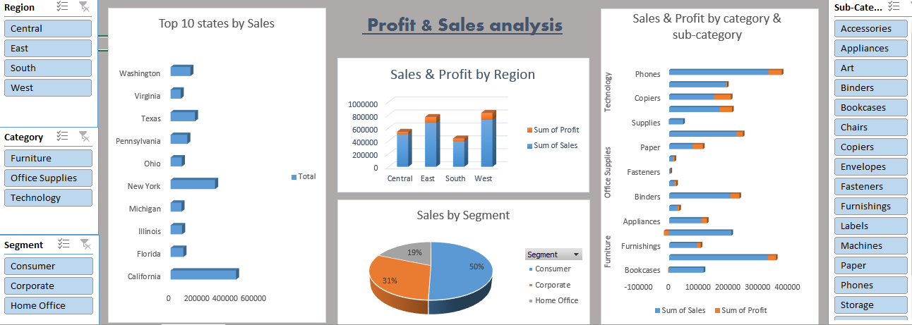
EXCEL DASHBOARD ANALYSIS
SLICER
BAR CHART
PIE CHART
USE FILTERS
STACKED BAR CHART
By using this visuals we have done profit and sales analysis on sample superstore dataset.

Slide 5
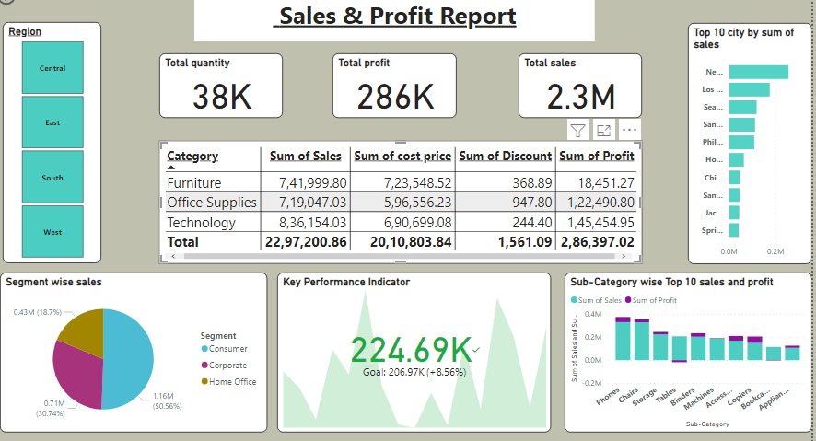
POWER BI REPORT
CARDS
Kpi
Bar graphs
Pie chart
Slicer
Table
Text box
Filters
Tooltips
By using these tools we have created POWER BI REPORT on sample superstore dataset.

Slide 6
Visualization tools
cards
Bar graphs
kpi
Maximum sales achieved is represented by key performance indicator that is located in bottom centre of the report.
3 cards are used to display the total quantity , total profit and total sales that is located in the middle of the report
2 types of bar graphs are used in the report one is stacked bar chart which is used for display the top 10 sub-category wise sales and profit and another one is horizontal bar graph that is use show to top 10 cities by sum of sales. Bar graphs are shown in the right side of the report

Slide 7
VISULIZATION TOOLS
slicer
filters
tooltips
Slicer is applied on region so the data can display for each region.
table
It display category wise the sum of cost price, qty, sales, profit which is located in middle of the report.
Filters are applied on bar graphs to display the top 10 values.
TEXT BOX
It is used to give the title for the the report which is located top centre of the report
Tooltips are used to give an additional information about that particular area.
PIE CHART
Is used for show the segment wise sales which is available left bottom corner of the report.

Slide 8
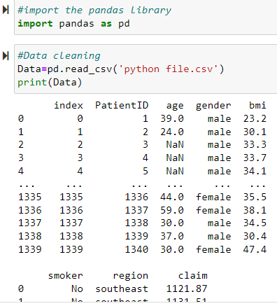
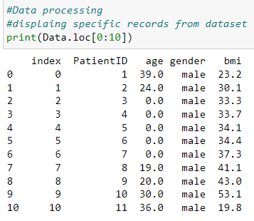
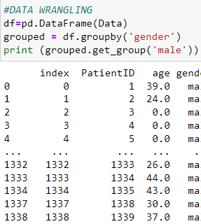
DATA ANALYSIS WITH PYTHON
We have used Insurance Claim Analysis dataset for data analysis by using PYTHON script.
LOADING, READING & CLEANING OF THE DATASET -
DATA PROCESSING & DATA WRANGLING OF THE DATASET -

Slide 9
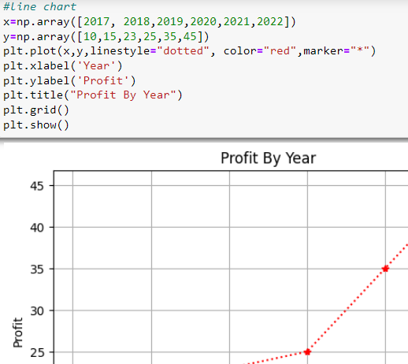
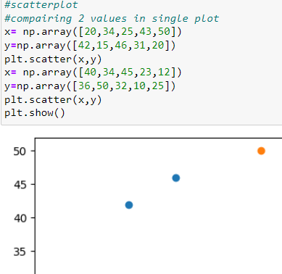
Data visualization with python we have created visuals in Python by using the respective data.
Line chart
scatterplot

Slide 10
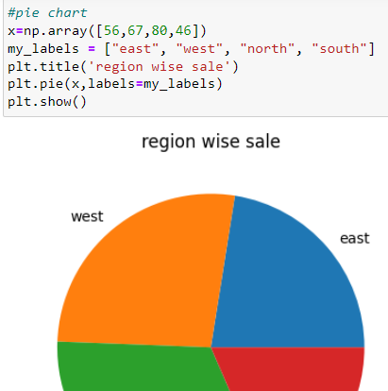
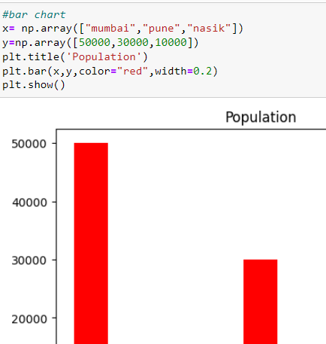
Pie chart
Bar graph

Slide 11
Thank you

